Slide 1
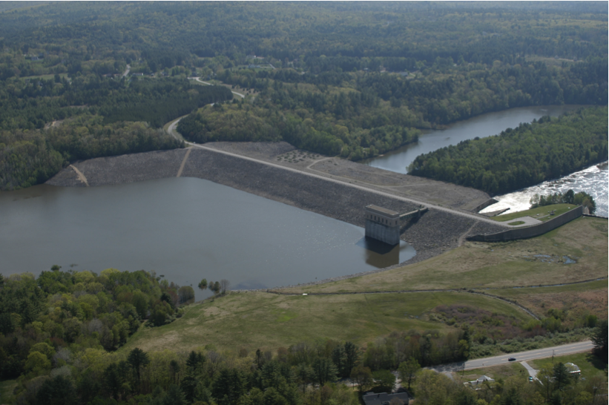
Developing confidence in critical state soil mechanics
12. Cyclic simple shear (NorSandPSR)
Mike Jefferies, PEng
Dr. Dawn Shuttle, PEng
January, 2015

Slide 2
Remember principal stresses
Y
σ₁
σ_{y}
τ_{xy}
σ₃
τ_{xy}
σ_{x}
X
All stresses ‘effective’ unless otherwise stated

Slide 3
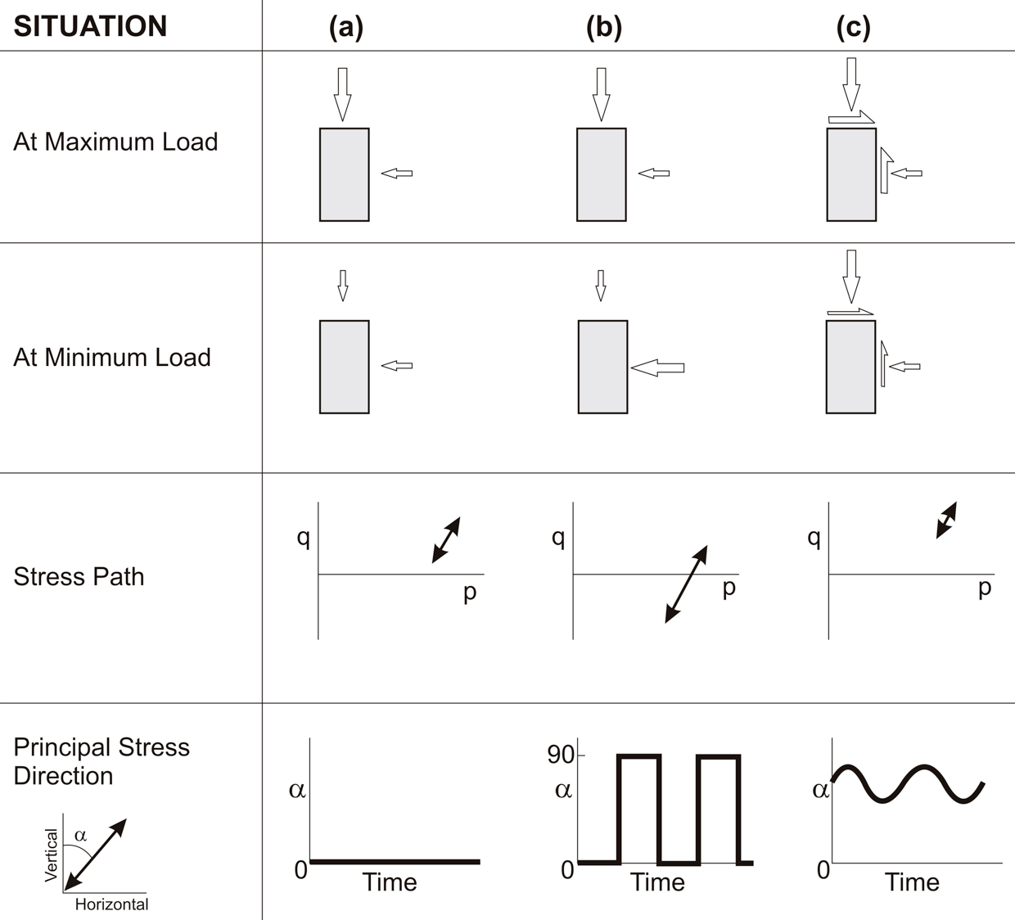
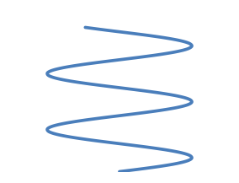
Principal Stress Rotation
σ_{q}

Slide 5
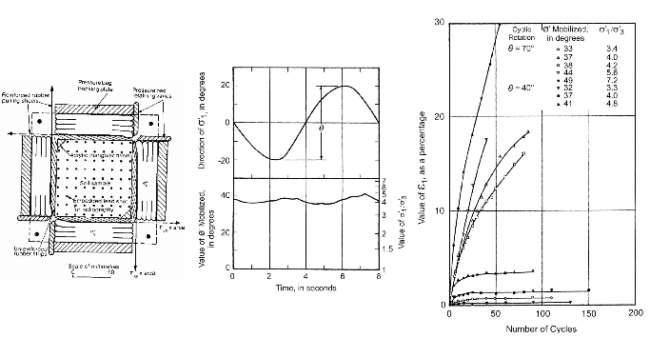
Arthur, Chua & Dunstan (1979)

Slide 6
Photoelastic disks

Slide 7
Rothenburg & Bathurst (1992)
Behaviour of idealized particles
in a computer

Slide 8
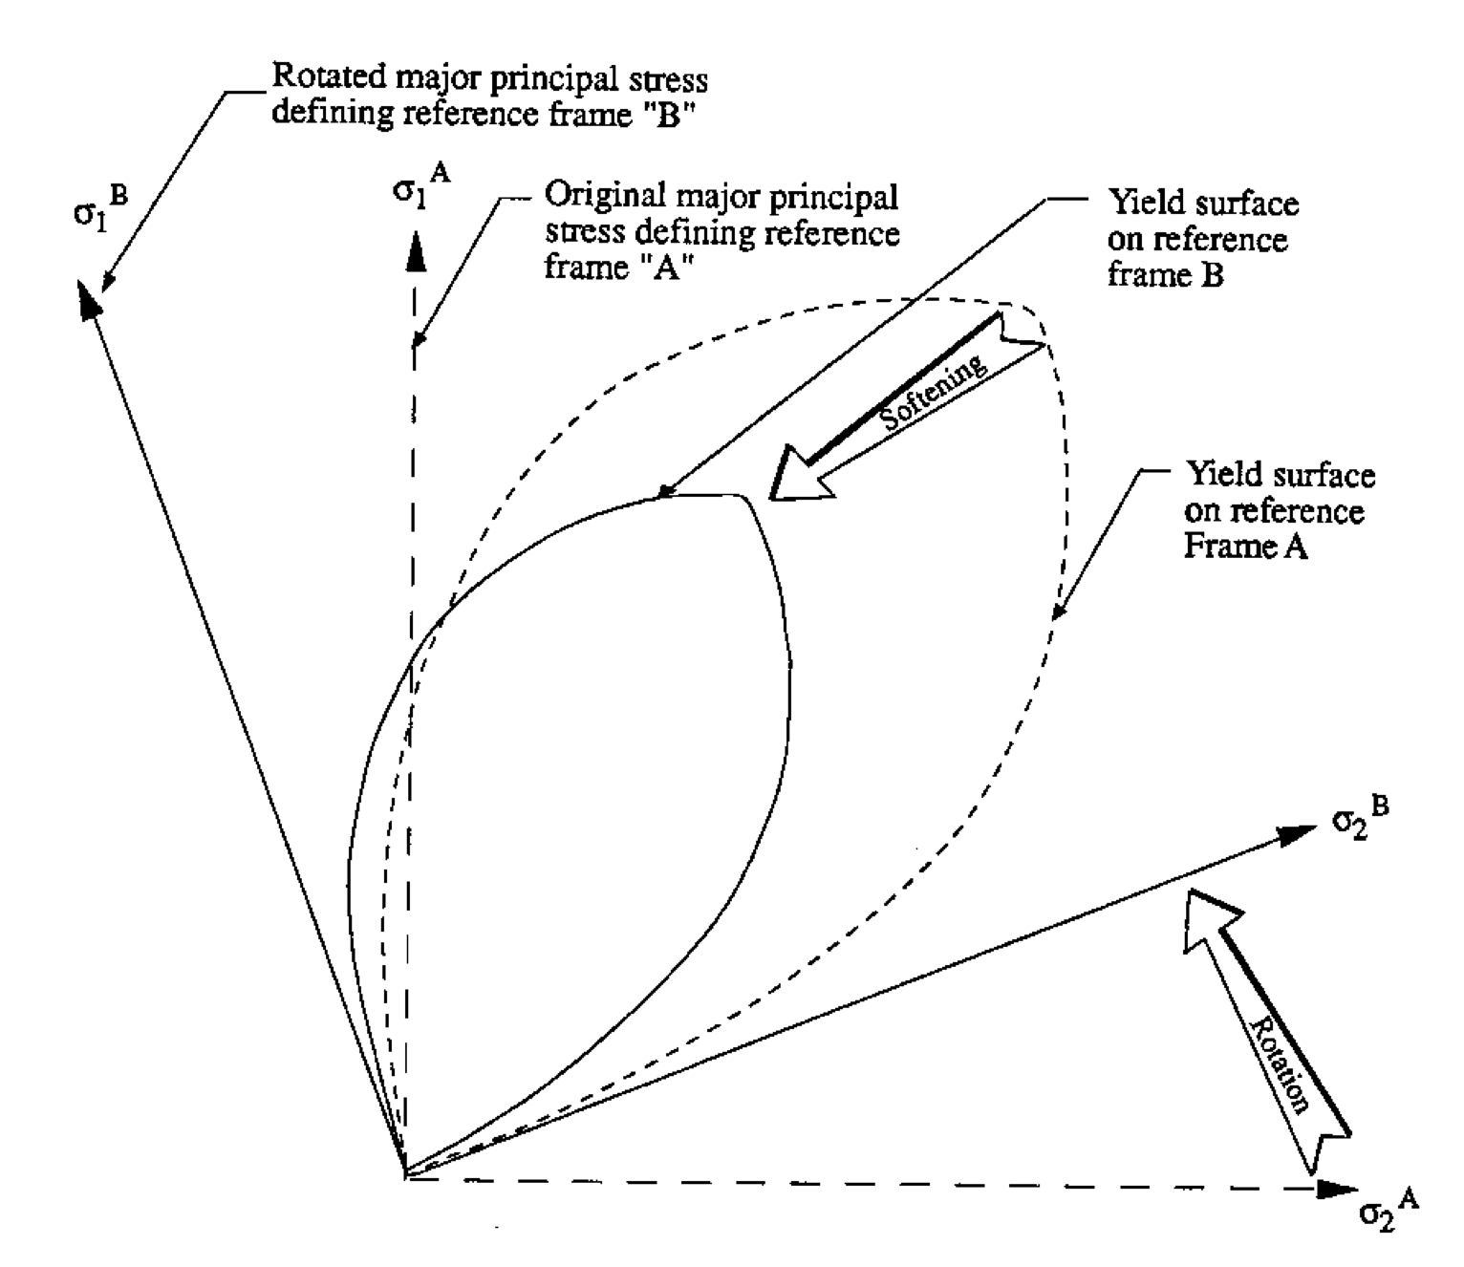
Idealization of PSR effect
Axiom 3: PSR always softens yield surface

Slide 9
Why do we care about PSR
Like to understand the empirical CRR curve using basic soil properties
Deep-seated contempt for “fines content correction”
    What is really going on
Like to understand Kα, Kσ

Slide 10
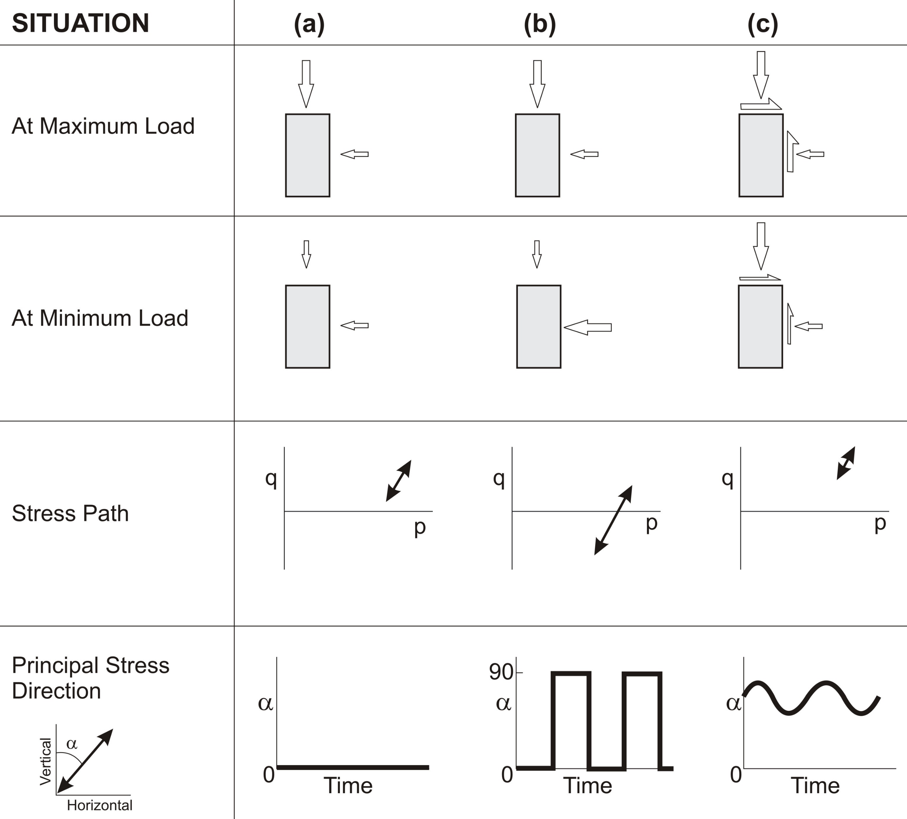
Irrelevance of cyclic triaxial tests

Slide 12
Limit views to simple shear

Slide 13
Static bias and PSR

Slide 14
Static bias and PSR

Slide 15
“Liquefaction Initiative” tests on FRS

Slide 16
Conditions in FRS database

Slide 17
Quickish liquefaction

Slide 18
High-cycle “fatigue softening”

Slide 19
Simple shear calibration: monotonic
Using properties measured in triaxial compression

Slide 20
UBC equipment not stiff enough for sands
After making lateral restrain made softer than “rigid”…

Slide 21
PSR-NorSand

Slide 22
With moderate static bias

Slide 23
Very dense test

Slide 24
PSR-NorSand not in Book (Free download)

Slide 25
Comments…
PSR-NorSand strict implementation of Arthur’s idea
Not quite right… elastic unloading in theory not seen in data

Slide 26
What we think is going on…

Slide 27
At instant of load reversal
“Non-coaxiality” of stress and strain increment: cos β

Slide 28
Non-coaxiality in CSS
β
dp_{i} = - p_{i} Z |β | de_{q}
Courtesy CUED

Slide 29
Pending…
Will shortly be able to predict CSS data in complete detail using:
    Soil properties measured in txl compression
    One new ‘annealing’ modulus
PhD thesis at Cambridge (Soga =>Berkeley)
    Implemented NorSand in ABAQUS
    Hansini Mallikarachchi: Added in non-coaxiality
NorSand variants
    Andrade (Northwestern)
    Borja (CalTech)

