Slide 1
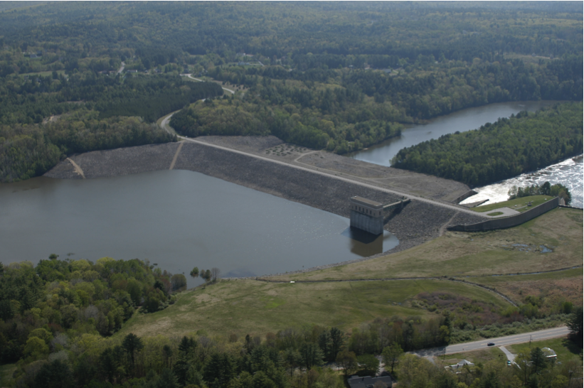
14. Closing Remarks
Mike Jefferies, PEng
Dr. Dawn Shuttle, PEng
January, 2015

Slide 2
Overview of where we have been
Characterized soil as ‘particulate’ leading to
    Fundamental soil properties:
    Controlled by ψ = e - e_{c}
Seen how CSSM follows from some simple ideas
    3 simultaneous eqn: yield surface, stress-dilatancy, hardening
    OCC makes an unnecessary assumption
    NS generalizes the framework properly
Calibration using fundamental soil properties
    Nicely captures loose and dense sand drained TXL data
    Dense, drained calibration nicely predicts undrained static liquefaction
Considered CPT
    Used CSSM to develop soil-specific CPT calibration
    Used calibration in xls to process CPT data for state

Slide 3
What was not covered
OCR….
    It is in the vba code
    A “dead” zone of elastic only until loadpath meets YS
    Idea simple, convoluted code
    Very useful in fitting tests – vertical undrained stress path = elastic
Plane strain
    No longer have σ₂ = σ₃,and ε₂ = ε₃, , so lots more to calculate
    Be very careful with strain invariants: use Resende & Martin
    J&S (2002) or Book
    VBA code available; SS more useful
    Public-domain C++ UDM for FLAC
    Public-domain FE source code (download from book website)

Slide 4
Simple shear (plane strain)… silt

Slide 5
Shameless commerce…
Some principal peer-reviewed references in hand-outs. BUT…
Text on critical state soil mechanics and its applications
    Liquefaction is secondary…
    Derivations in painful detail
Lots of associated data files and documentation
Trust is wonderful...
But, distrust is better !

Slide 6
Wrap up
Hope you have enjoyed the course… CSSM is an acquired taste
Brit view: “CSSM most significant contribution to soil mechanics of 20thC”
    Not an over-statement
    It is the only “good” framework we have for soils
    Ought to recognize US influence (and Canadian !)
You may be feeling a bit overwhelmed….
    Read the course notes
    We’ll answer questions that occur to you
geomek@hotmail.com dawn_shuttle@Hotmail.com

