Slide 1
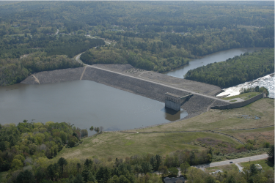
5. Elasticity
Dr. Dawn Shuttle, PEng
Mike Jefferies, PEng
January, 2015

Slide 2
Elasticity
Slight detour required – as we do not have time to calibrate elasticity in this workshop………..
BUT – elasticity is important.
ELASTICITY
    This is the small strain value – “G_{max}”
    Forget strain-dependent elasticity as this doesn’t exist.
    “Measured” by bender elements in the lab
    “Measured” by the seismic CPT in the field

Slide 3
Measuring shear modulus: “G_{max}”
Elastic wave theory: G = ρ V_{s}²
Tame seismic source
V_{s} = Range / ΔTime
Source geophone
P-wave arrival
Whacking left
Downhole
geophone
S-wave arrival
Whacking right

Slide 4
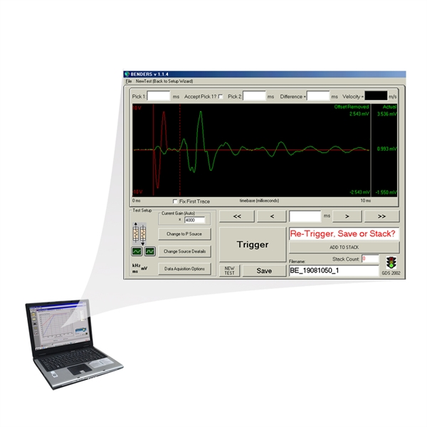
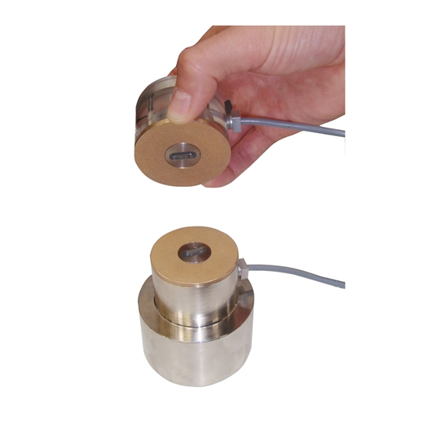
Measuring G_{max} in the laboratory
‘Ping’ right
‘Ping’ left

Slide 5
Fraser River Sand
Has laboratory test bender elements
Good range of soil density
Benders measuring during triaxial test
(so shows “strain dependent elasticity – or lack thereof!)

Slide 6
Fraser River Sand Benders
Bender elements were used with 7 triaxial tests
  2 bender tests were on “crushed” FRS
  Measurements taken during both consolidation and shearing stages
Fitted equation of the form
….to the shearing portion of the uncrushed triaxials.
where A, e_{min} and b are fitted soil properties
p_{ref} is 100 kPa (or equivalent in same units as p′)

Slide 7
Goodness of fit – fitting data shown

Slide 8
Elasticity - fit
A = 375
e_{min} = 0.344
b = 0.466

Slide 9
Elasticity – simpler equation for workshop
For simplicity the workshop spreadsheet adopts the simpler (but less accurate) equation:
…where a and b are fitted parameters, p_{ref} = 100 kPa.
Typically use this simpler equation (without void ratio) because if subsequently applying to field conditions you’ll likely not know in situ void ratio.

Slide 10
Elasticity – simpler equation for workshop

Slide 11
Elasticity – simpler equation for workshop
loose (CID)
dense & compact (CID & CIU)

Slide 12
No ‘strain dependent modulus’
The small G_{max} changes measured are all caused by changing p′ in the test

Slide 13
Now to Nerlerk Sand (much older data…)

