Slide 1
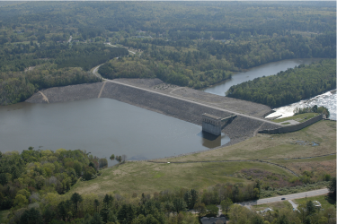
8b. CPT – Quantitative evaluation: SAND
Determining ψ insitu
Mike Jefferies, PEng
Dr. Dawn Shuttle, PEng
January, 2015

Slide 2
CPT resistance in uniform soil
Tip..
Friction..
PWP..

Slide 3
Calibration chamber for the CPT in SAND
…see Book for complete set of world’s calibration chamber data
Esso Resources Canada, Dome Petroleum, Gulf Canada Resources

Slide 4
Sorting out CPT “interpretation”
BASIC ISSUES
How stress level affects q_{c}-D_{r}
How soil properties affect q_{c}-D_{r}

Slide 5
Getting ψ from the CPT Been et al (1987)
Stress-normalized CPT resistance, Q
Q
State parameter, ψ
Esso Resources Canada, Dome Petroleum, Gulf Canada Resources

Slide 6
Sands calibrated to CPT
Hilton Mine Tailings (Harman, 1976)
Ottawa (Harman, 1976)
Reid Bedford (Lhuer, 1976)
Ticino (Baldi et al, 1982 & 1986; Golder, 1987)
Monterey (Tringale, 1983; Huntsman, 1985)
Erksak (Been et al, 1987)
Hoksund (Lunne, 1986; Baldi et al, 1986)
Chek Lap Kok (Shen & Lee, 1995)
West Kowloon (Shen & Lee, 1995)
Syncrude Tailings (Golder 1988, pbl 2006)
Yatesville silty sand (Brandon et al, 1990)

Slide 7
Sands calibrated to CPT
Same equation for each sand, just with different k,m values

Slide 8
Sladen’s intervention…

Slide 9
At some point you have to do “the math”
How can a properly dimensionless framework be wrong ?
Need large displacement computations
    ‘moving mesh’ convects work and this needs including in solution
    convection also depends on dilation
    Zienkiewicz FE book not correct
    Appears simple, but actually rather sophisticated numerics
Approach
    Verify numerical implementation against constant friction, constant dilation soil for which “semi” closed-form solutions exist
    Verify numerical implementation of NorSand against direct integration for laboratory element tests
    Combine two verified modules to compute CPT behaviour

Slide 10
Doing the “the math”
q_{c} =C_{Q} P_{limit}

Slide 11
Cavity expansion

Slide 12
Cavity expansion analogue…….
CPT

Slide 13
Doing “the math”: cavity expansion
Cavity pressure
q_{c} =C_{Q} P_{limit}
Cavity displacement
Bishop, Mott & Hill (1945)

Slide 14
Scaling factor and data scatter
E139
...Identical reported e₀, p₀
I169
I_{r} = G_{max}/p’₀
C_{Q}

Slide 15
Single sand: Q = k exp(− m ψ )

Slide 16
Effect of G_{max} on Ticino CPT calibration
“Variable exponent” normalizations of CPT data are attempting to approximate the effect of G_{max} on the penetration resistance (and doing so badly)
ψ = - m ln(Q/k)
f( G_{max} / p’)

Slide 17
Generalization from Ticino to all CC sands
331 calibration tests
80% ± 0.04

Slide 18
Site-specific CPT calibration
Cavity expansion of NorSand is a pretty good analogue to CPT penetration resistance in calibration chambers
Determine soil properties
    M, N, λ₁₀, χ, H… reconstituted samples (judgment ?)
    Measure G_{max} insitu
    And then there is K₀… 0.7 in alluvial deposits ?
Use numerical method
    “widget”

Slide 19
What is the Widget
Spherical idealization
  1-D (= radial)
Coded specifically for this particular geometry
  Efficient… P_{limit}
Needs geometry correction C_{CPT}
  Has been calibrated to true CPT geometry
  (from calibration chamber tests)
q_{c} =C_{CPT} P_{limit}

Slide 20
Where is the Widget ?
Folder: /Data & Templates/ CPT programs/ CPTwidget/SandExample
Contains six files:
  CPTwidget_V2p5.exe
  CPTwidget.FIL
  SandExample.DAT
  SandExample.VAL
  WidgetSandExample_V2p5.xls
  SandExample_val.xls

Slide 21
The Widget
CPTwidget_V2p5.exe
    Finite element spherical code
    Fortran – but being updated to C++
    Is set up to batch a series of CPT simulations
    “double click” to run
  CPTwidget.FIL
    Ascii text file
    Contains the root name of the simulations
    Your file contains the single word “SandExample”
    Do not change the name of this file

Slide 22
The Widget
SandExample.DAT
    Ascii text file
    Contains:
      NorSand Calibration
      Mesh geometry
      Range of Simulations to run
        So if you need to stop the run you do not need to rerun from scratch
      Numerical tolerances

Slide 23
SandExample.DAT
    Soil Model - 1=NorSand
    1
    NumNodes, MaxStrain(%), incU
    71 500 5.e-4
    toler, fmaxtol, tstepfac
    5.e-5 1.e-5 0.1
    Outer Radius
    250.
DO NOT ALTER
RARELY ALTER
ALTER IF NEEDED

Slide 24
SandExample.DAT
Mtc Ntc lambda(log_e) Gamma(@1kPa) Pref Chi
1.45 0.43 0.06 1.22 1.0 4.85
H0 Hy
42 310
R (~ OCR)
1.00
Gpower Poisson
0.5 0.2
NorSand calibration:
(edit for other soils)

Slide 25
Example1.DAT
PoreMod
0.0
istart istop
40
Pore water modulus
Drained = 0., Undrained = 10⁹ Pa
controls which simulations are run

Slide 26
SandExample.VAL
SandExample.VAL
    Ascii text file
    Contains the in situ conditions for the individual simulations
    Only 3 inputs
      p₀ ψ₀ I_{r} (= G₀/p₀)
    One row for each simulation
    To set up the .VAL file open in Excel and export as an Ascii file

Slide 27
SandExample.VAL
Ir = 100
p₀ = 100 kPa
Ir = 250
Ir = 500

Slide 28
Run the CPTwidget
Now start the simulations !
Find CPTwidget_V2p5.exe
“double click” to start
Edit CPTwidget.fil to contain SandExample

Slide 29
SandExample.OUT
SandExample.OUT contains the simulation results
Most easily explained by opening in Excel and plotting the results…..
Open and paste “space separated” into
“0 > raw data” sheet

Slide 30
0 > raw data
Not enough simulations complete, so stop the Widget running and open “one we prepared earlier” from handouts/CPTwidget/Results

Slide 31
parametric_data_plot.xls
Open Widget_SandExample_V2p5.xls
Look at the “1> paste data from Widget” sheet headings
Q_{p}=(q_{t}-p₀)/p₀’
ψ₀

Slide 32
parametric_data_plot.xls

Slide 33
Qp vs state

Slide 34
Qp vs state
k = 24.65
m = 8.29

Slide 35
Example results
Now open SandExample.OUT in Excel
Paste into the “0 > raw_data” sheet of WidgetSandExample_V2p5.xls
Copy over to the corresponding simulation range in “1>paste output from widget”
Review plotted results in “2 > fit trends”
Add exponential trend lines……
What are the values for m and k ?

Slide 36
Example results
In the “2 > fit trends” sheet
For each Ir type in your derived k and m into the spreadsheet

Slide 37
SandExample data

Slide 38
Example results
View the k and m trend with Ir in the “3 > view calibration” sheet

Slide 39
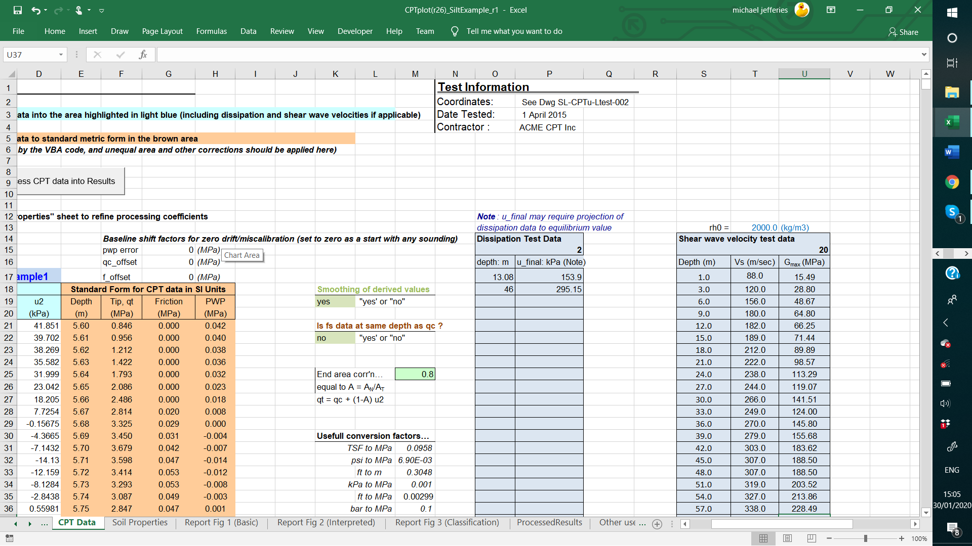
Back to our plotting program: CPTplot.xls
Interpretation Step 1: Input G_{max}

Slide 40
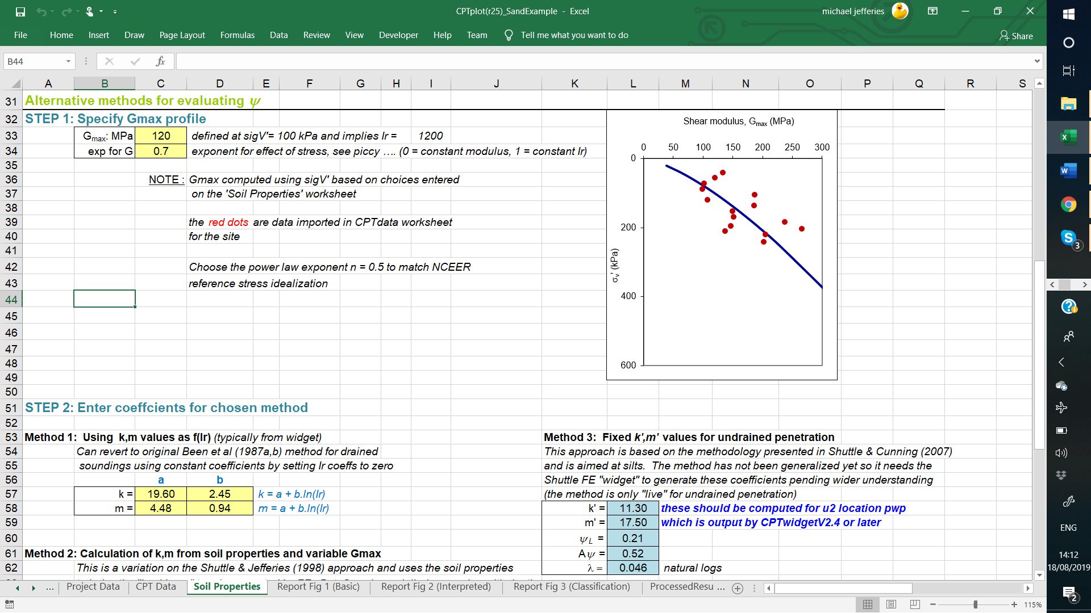
Representing G_{max} for evaluating CPT data
Calcs use G_{max} trend

Slide 41
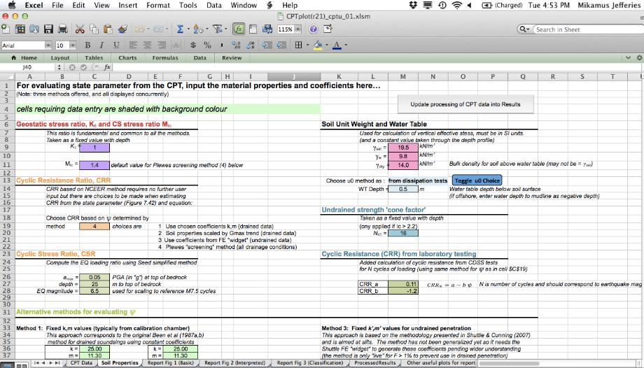
Choosing ψ method

Slide 42
Options for ψ method in CPTplot.xls
Method 1: Specify k, m for use in drained part of sounding
    From assessment of calibration chamber data (eg Been et al, 1987)
    Use CPTwidget to compute k, m
Method 2: Specify soil properties for use in drained part of sounding
    Trends for k,m based on extensive parametric simulations
    Needs soil properties M, λ, H…
Method 3: Specify k’, m’ for undrained part of sounding
    Use CPTwidget to compute k’, m’
Method 4: ‘Universal Method’ …always a background result
    Infers key soil properties from CPT every ~100 mm
    Minimal soil property input
Undrained if: |B_{q}| > 0.1 or F > 1%

Slide 43
Method 1: drained soundings (effective stress)
Method Inputs
k, m
Options:
1a – use Widget
1b – chamber data

Slide 44
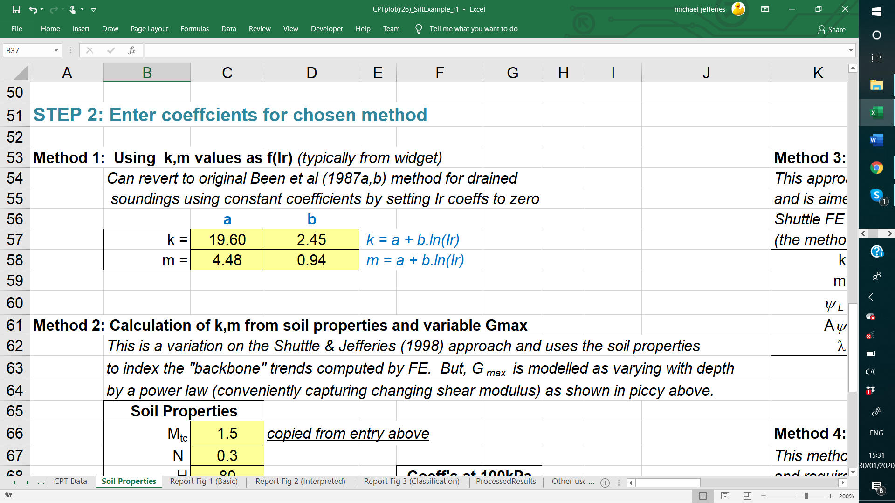
Widget input to CPTplot

Slide 45
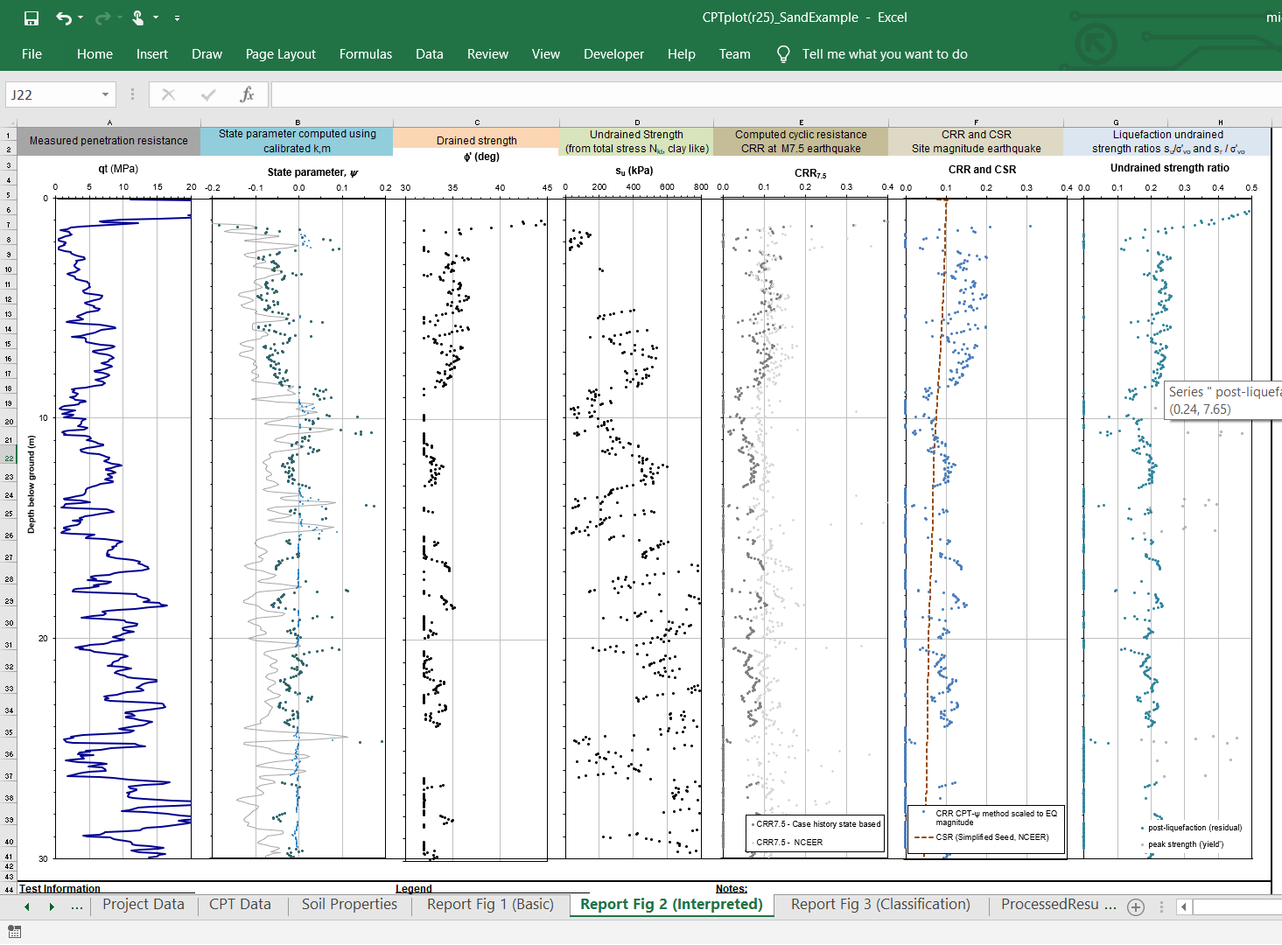
Output from Method 1

Slide 46
Method 2: Influence factors

Slide 47
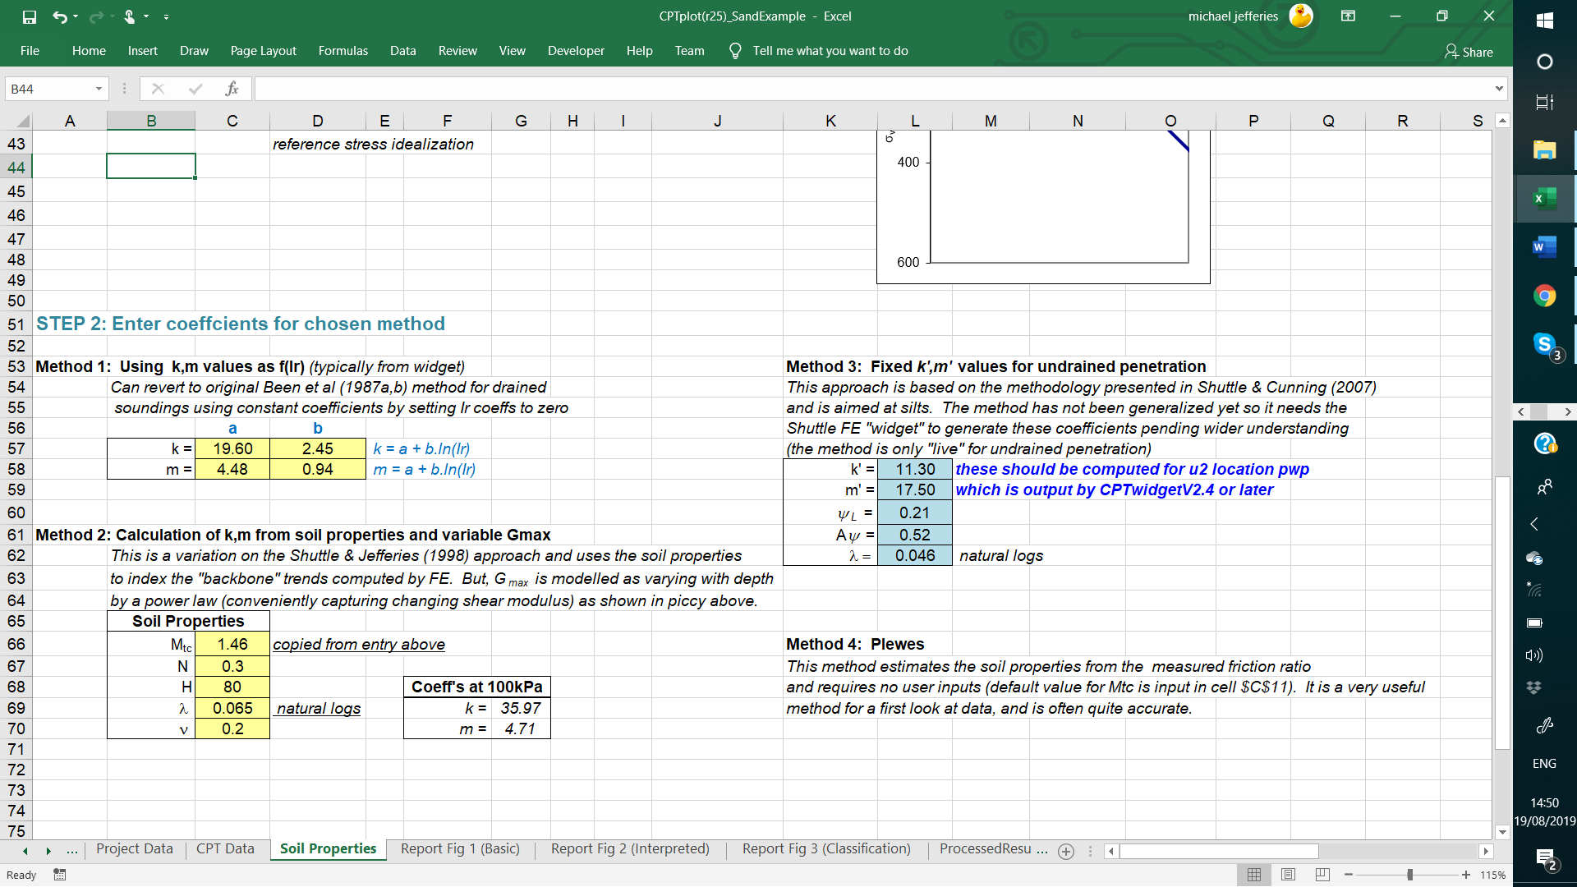
Input for Method 2

Slide 48
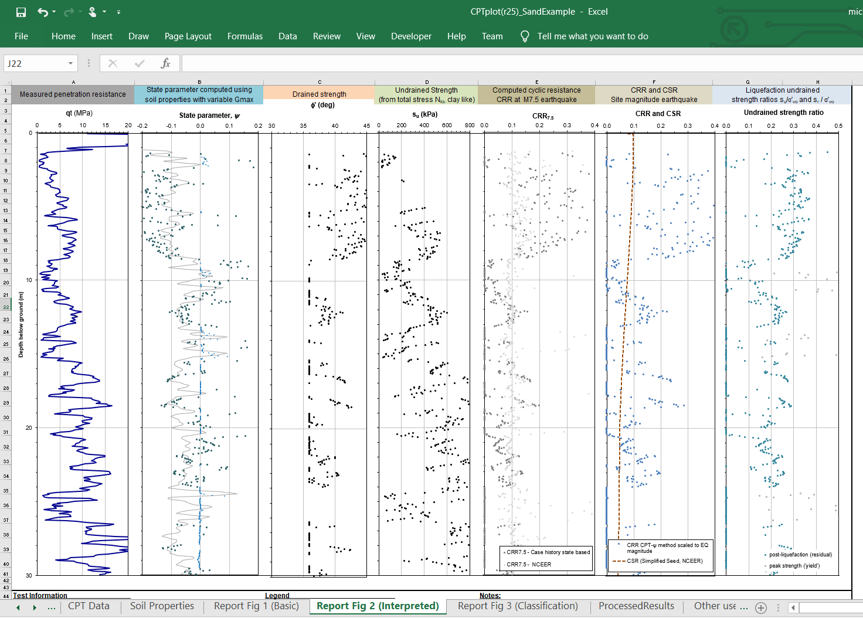
Output for Method 2

