Slide 1
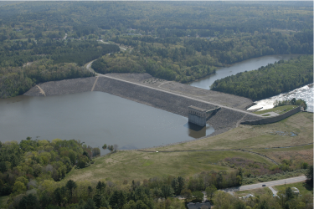
8c. Determining ψ in SILT with the CPT
Mike Jefferies, PEng
Dr. Dawn Shuttle, PEng
January, 2015

Slide 2
Calibration of CPT in Silt
NO calibration chamber tests…
Methodology
    Assume spherical =>CPT mapping in silt same as sand for effective component of tip resistance: C_{Q} silt = C_{Q} sand
    Assume pore pressure is unscaled: u_{comp} = u_{meas}
    Check against field data using water contents
    Same “widget”
Dimensionless resistance:

Slide 3
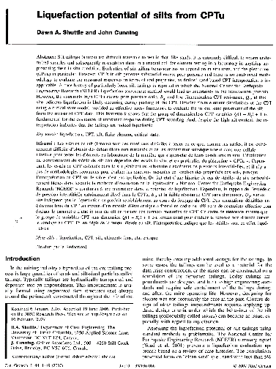
Pore pressures during CPTu sounding
q_{t} =C_{Q} P_{limit} + u₁

Slide 4
Widget development
Geotechnical Research
Volume 3 Issue 3, Sept/2016
Ver <2.3… external u₂ u₁
Ver >2.4… internal u₂, u₁
Ver 2.3
u₂
u₁
www.icevirtuallibrary.com/doi/full/10.1680/jgere.16.00008

Slide 5
Using widget for silts
SAME EXE !
    Run undrained by changing bulk modulus of pore fluid
    .dat file sets poremod = 10⁶ kPa
Process just the same as drained
Recover k’, m’ for use in CPT data reduction
Also outputs B_{q} at u₂ location

Slide 6
Moving from sands to silts: Q(1-B_{q@1}) + 1
Houlsby (1988)

Slide 7
Moving from sands to silts: Q(1-B_{q@2}) + 1
Houlsby (1988)

Slide 8
You also have B_{q@2} data to use as check
ψ₀ = B_{q2} ψ_{L} / (Α_{ψ} + B_{q2})

Slide 9
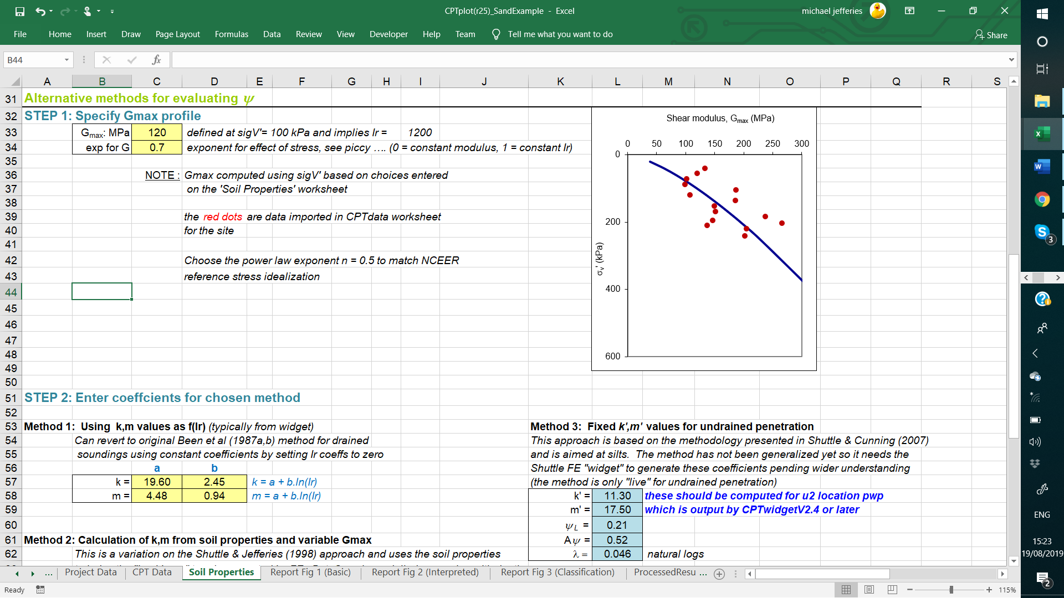
Method 3 Input to CPTplot.xls

Slide 10
N_{kt} from CPTwidget

Slide 11
Example results

Slide 12
Reality check in absence of chamber
High-quality piston samples in “uniform” strata
    Use CPT to identify sampling locations
    Laboratory tests to define representative CSL
Measure water content on as-recovered samples
    Total sample ?
    Sub-sample from base of tube ?
Compute ψ for comparison with inferred ψ from CPT

Slide 13
Widget validation: Cadia (Figure E4-5)

Slide 14
CAUTION !
Loose silts at the “bleeding edge” of soil mechanics
Use your judgment and careful validation checks
Key case-history data locked up under ‘Legal Privilege’
    Mt Polley
    Fundao
    Cadia

Slide 15
Going forward...
UWA ‘tailings initiative’
    Includes CPT calibration chamber with silts
    Chamber exists, but no tests yet
Perfectly reasonable (and viable) for project-specific tests

